Slide 1
Space Flight

Slide 2
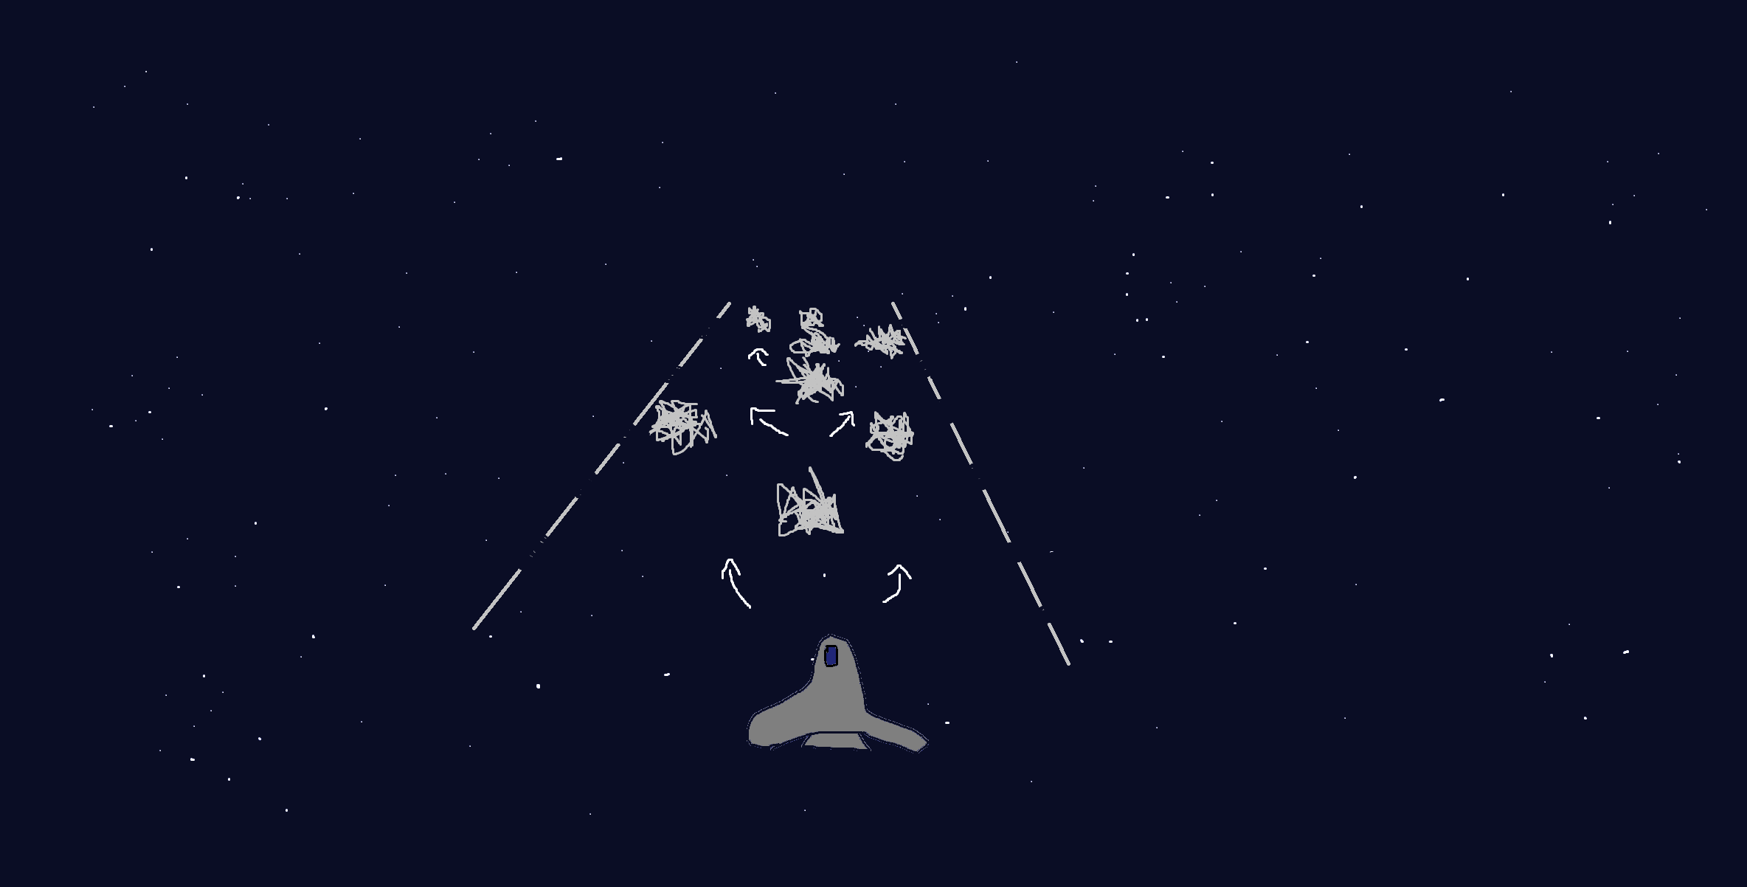
Design and Planning
High Score: 378
Score: 159
Figure 1.0. Game Design Sketch. Shows the planned view during gameplay. A is the player, B are the borders that mark the play area (the players cannot got outside of these), C are just a visualisation of the player movement during gameplay, and D are the obstacles to avoid.

Slide 3
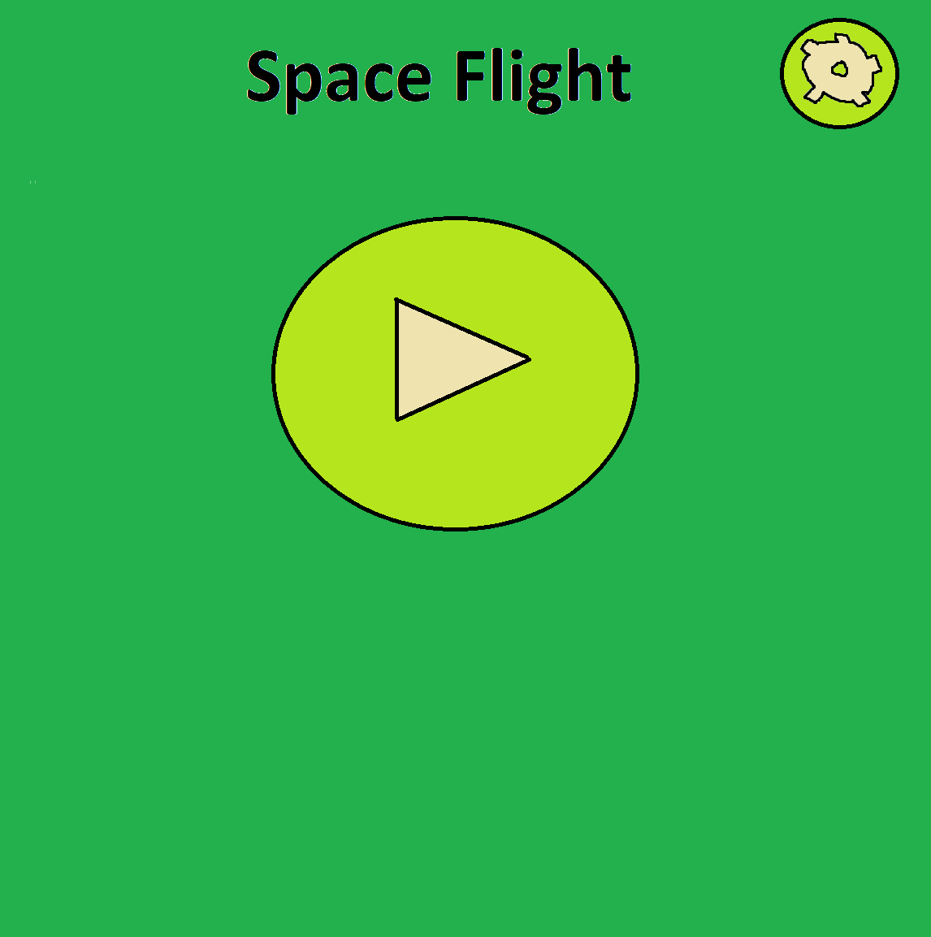
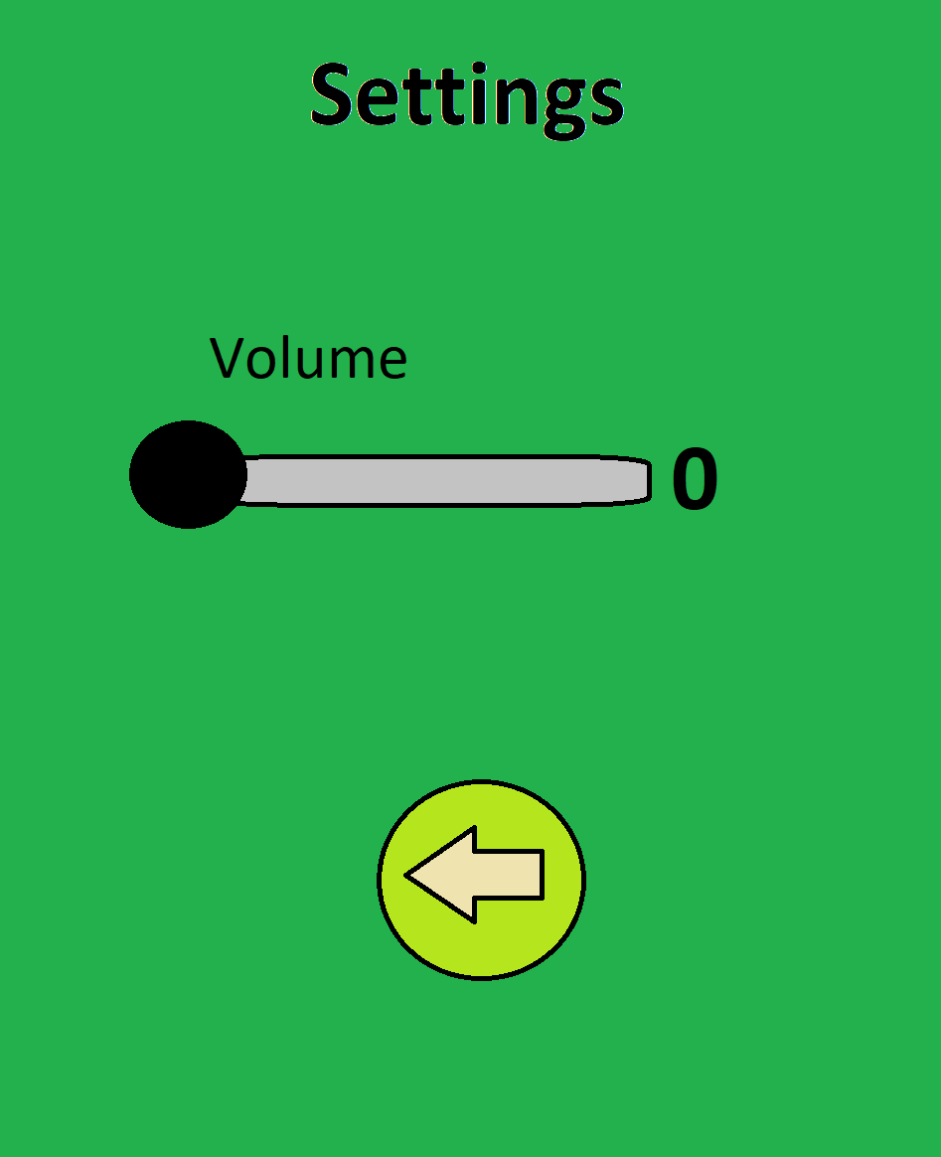
Design and Planning
Figures 1.1 and 1.2. Main and Options Menus. These show the initial design of the menus that I wanted to go for.

Slide 4
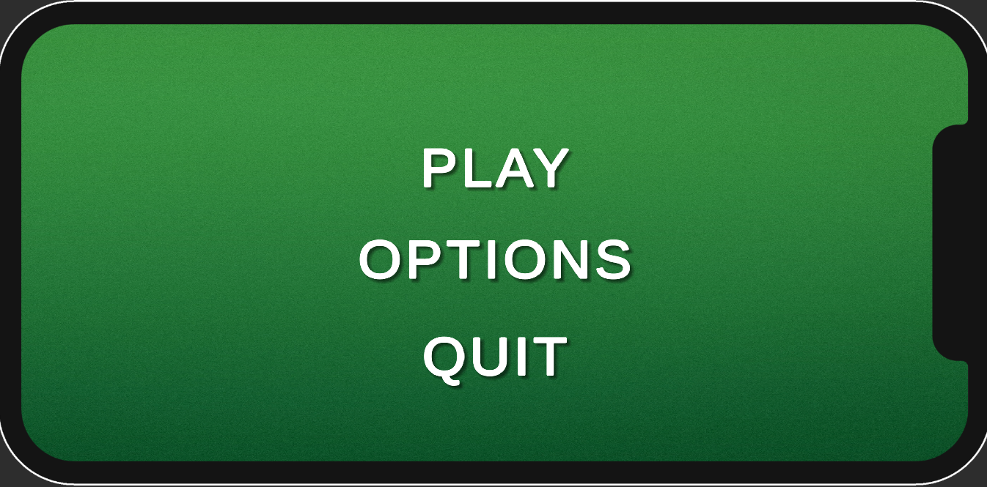
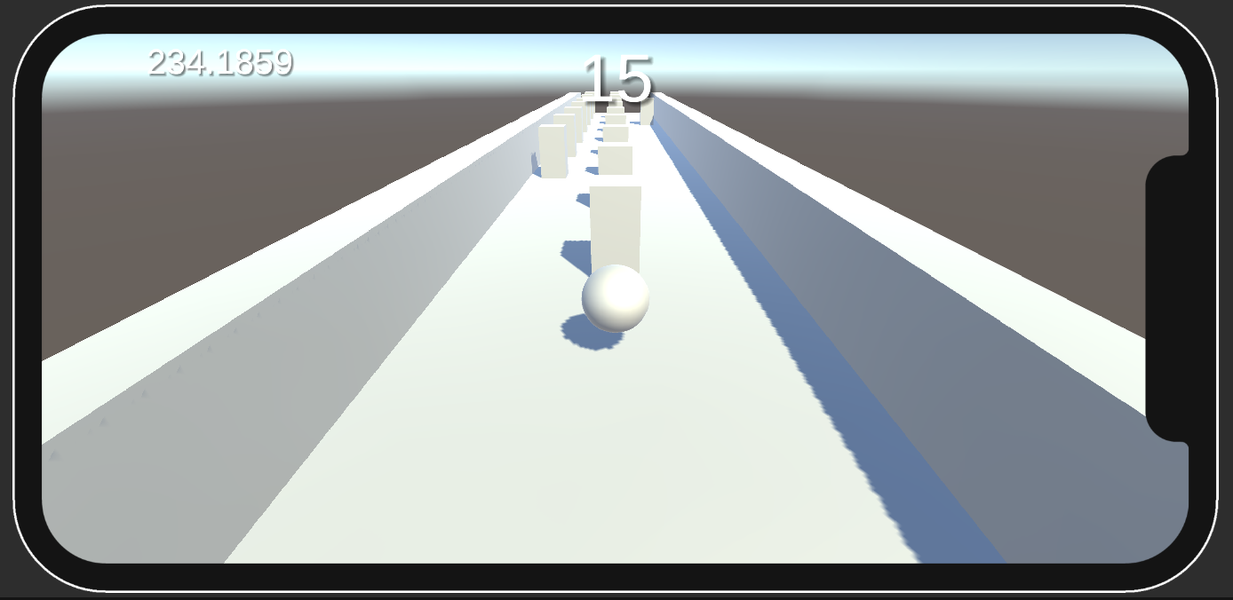
Early Development
Figures 1.3 and 1.4. Main Menu and Gameplay Scene. These show what the game first was when some of the core functionality was in place.

Slide 5
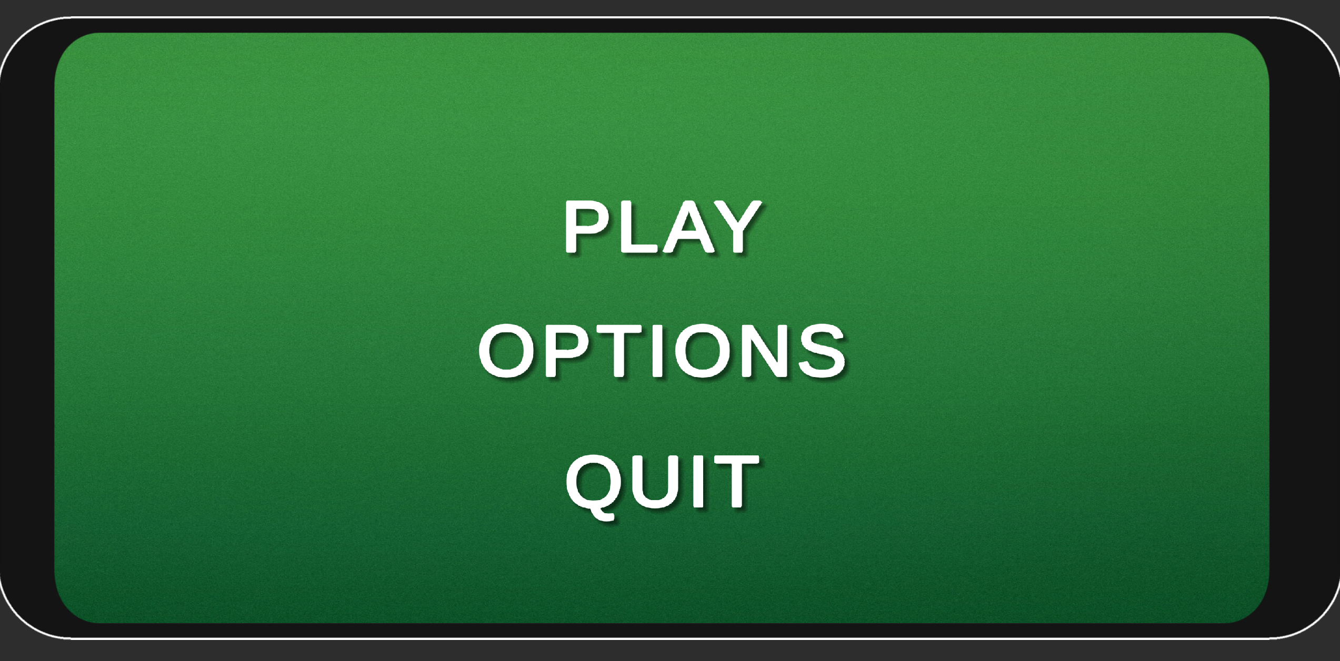
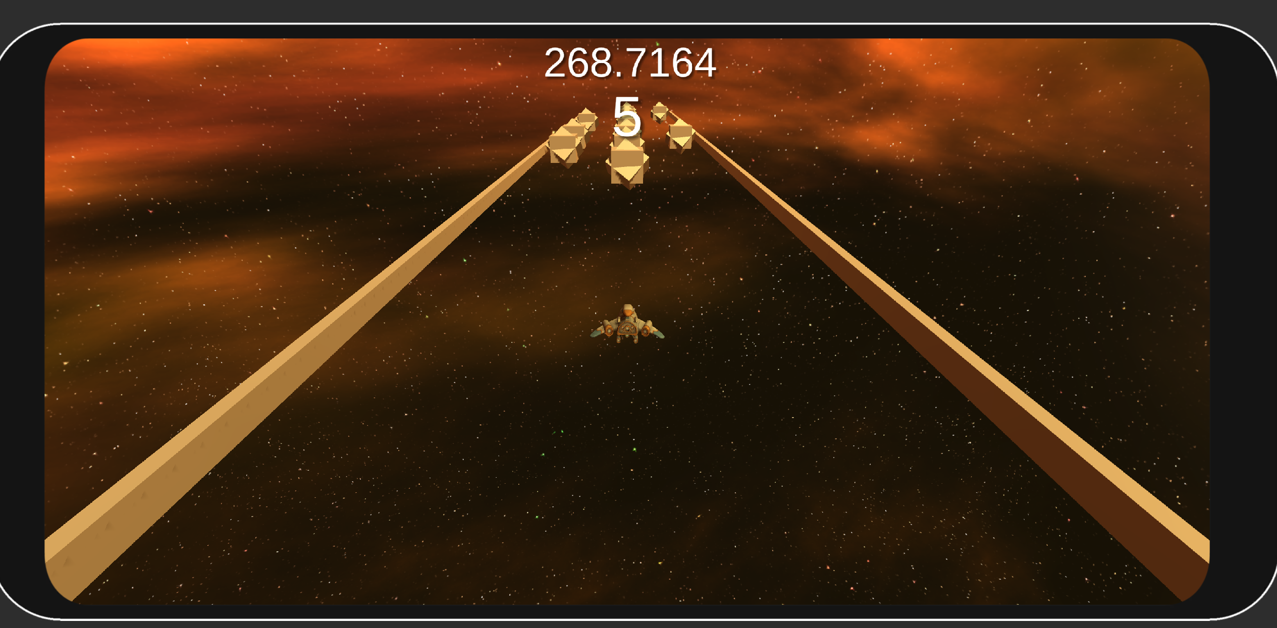
Evolution - The Prototype
Figures 1.5 and 1.6. Updated Main Menu and Gameplay Scene. Here, the obstacles were changed to a second version of placeholder assets. Player + skybox added.

Slide 6
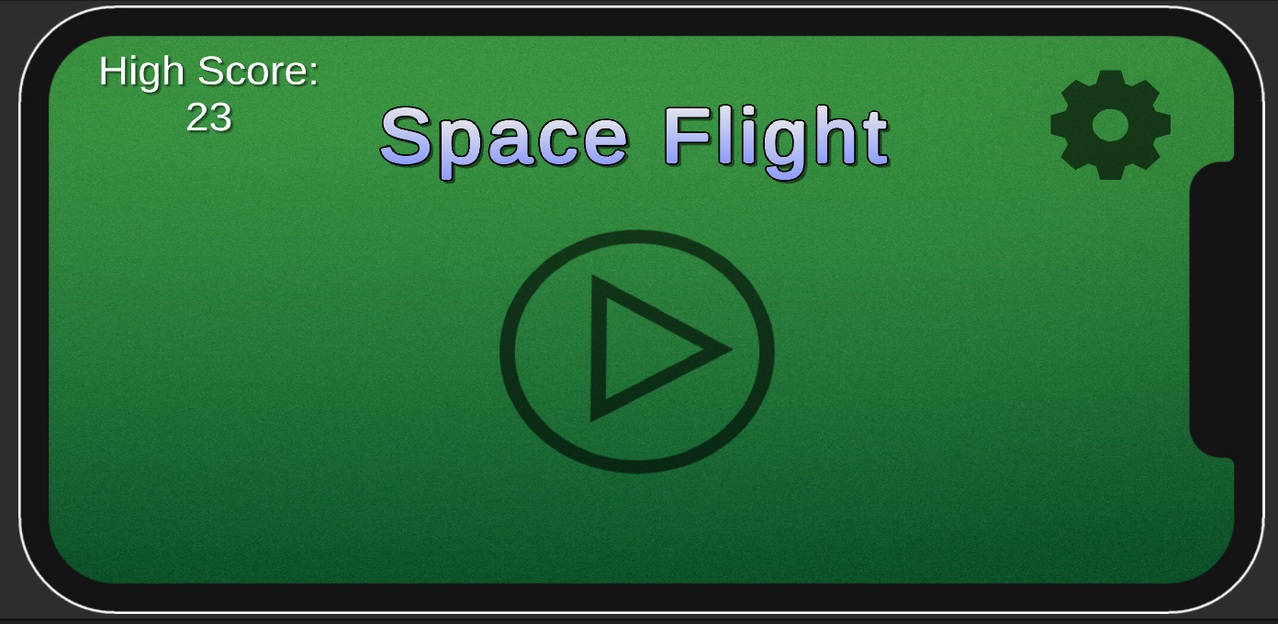
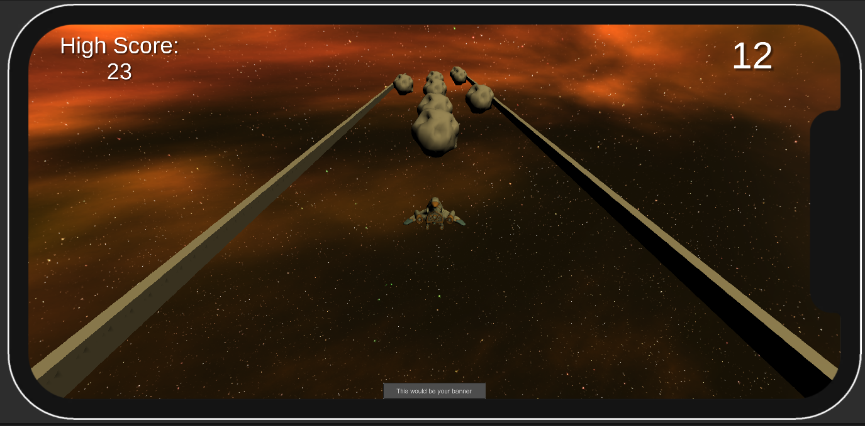
Evolution – Final Product
[A]
Figures 1.7 and 1.8. Final Main Menu and Gameplay Scene. The obstacles placeholder assets replaced, ads added (see banner add in Figure 1.8 [A]).

Slide 7
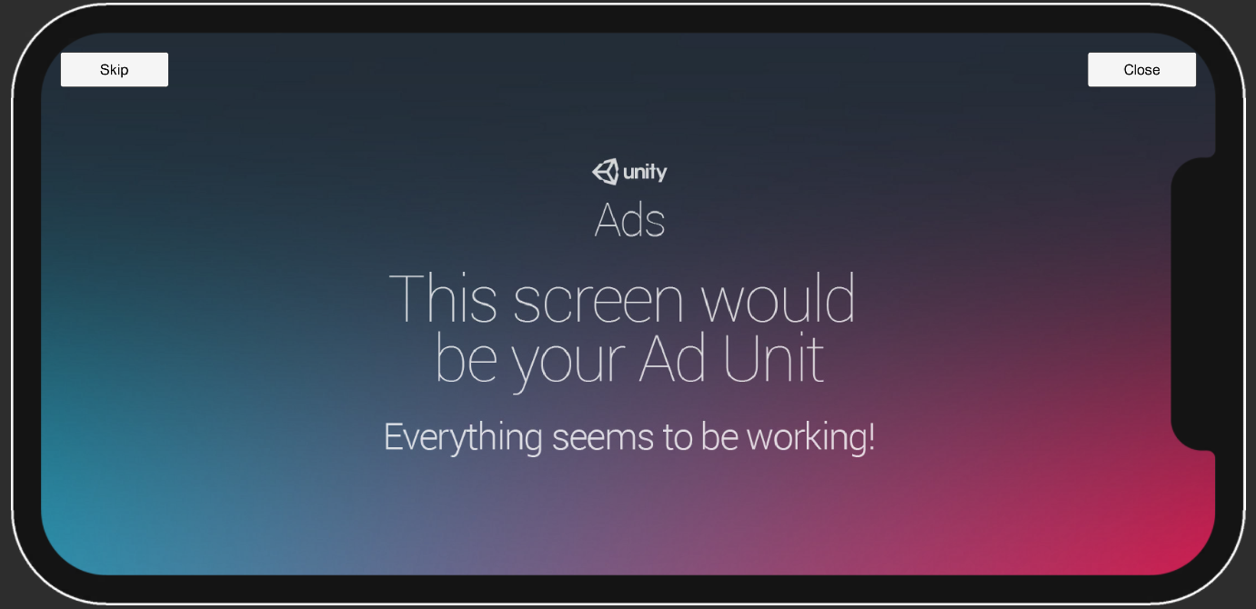
Evolution – Final Product
Figure 1.9. Interstitial ad. It appears whenever the player dies. When they close the ad, they’re taken to the main menu.

Slide 8
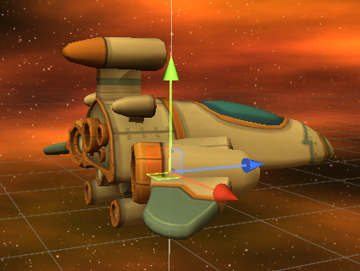
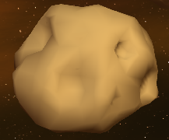
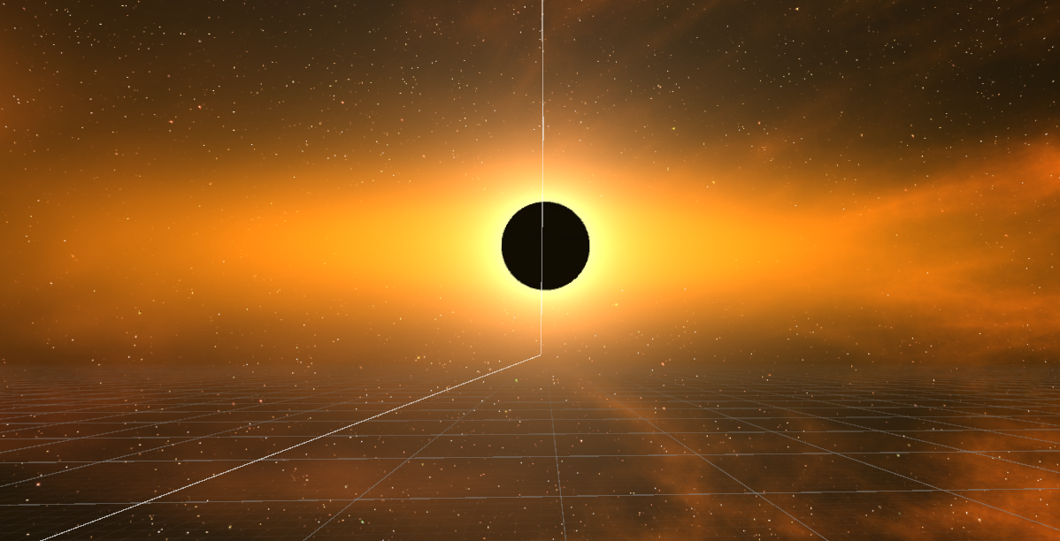
Assets and Scenes
There are two scenes – the menu scene (main menu and options menu) and the gameplay scene
Assets include player model, obstacle model, and skybox texture
Figure 2.0. Player Model. A spaceship since it’s a space-themed game.
Figure 2.1. Obstacle Model. A simple asteroid.
Figure 2.2. Skybox Texture. View of space.

Slide 9
Target Platform Research + Frameworks
Testing on different devices through Unity simulator to ensure that the UI works on different screen sizes etc.
Monetization strategy through the use of Unity Ads framework – interstitial ads and banner ads
Looking into content guidelines – the game targeted towards kids however it does not contain prohibited content
Using accelerometer instead of gyroscope for battery consumption consideration

Slide 10
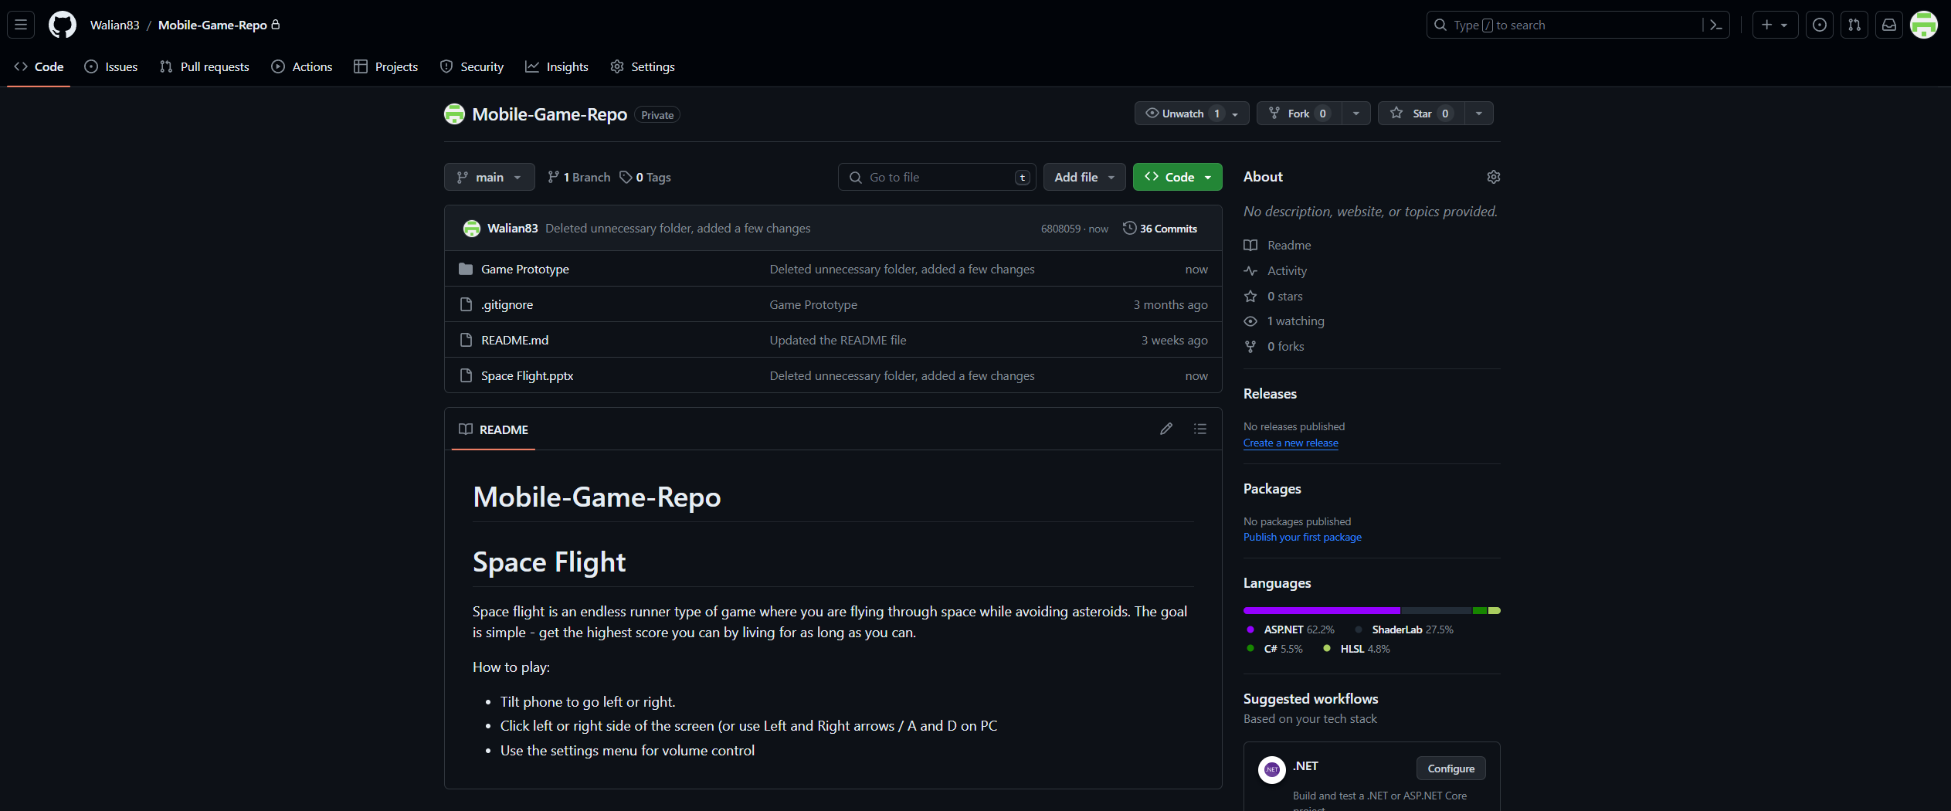
Github Repo
Figure 2.3. Github Repository. Used for version control and storing documentation + game description and how to play.
Link to the repo (was made public): https://github.com/Walian83/Mobile-Game-Repo

Slide 11
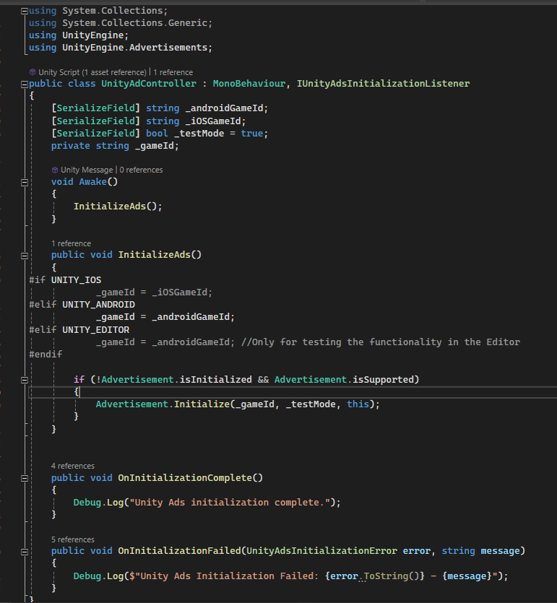
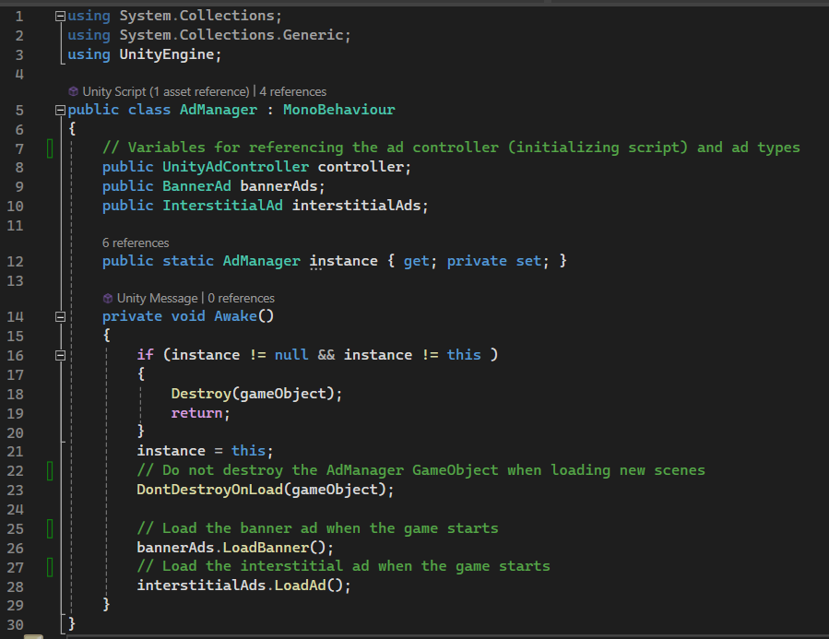
Code
Figure 2.4. UnityAdController.cs. This is a script that initializes the ads when the game starts.
Figure 2.5. AdManager.cs. This script takes care of loading the ads when the game starts. It also ensures they’re not destroyed when game scene is changed.

Slide 12
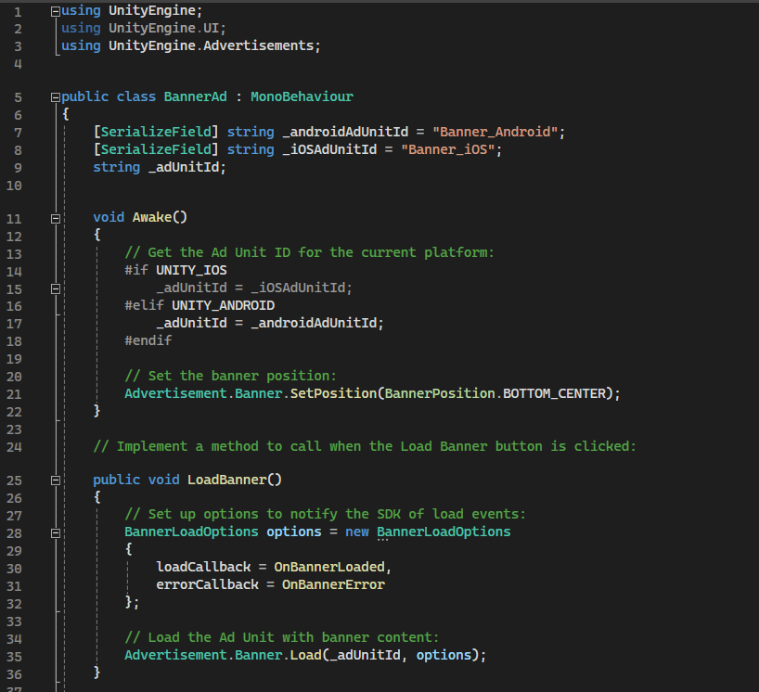
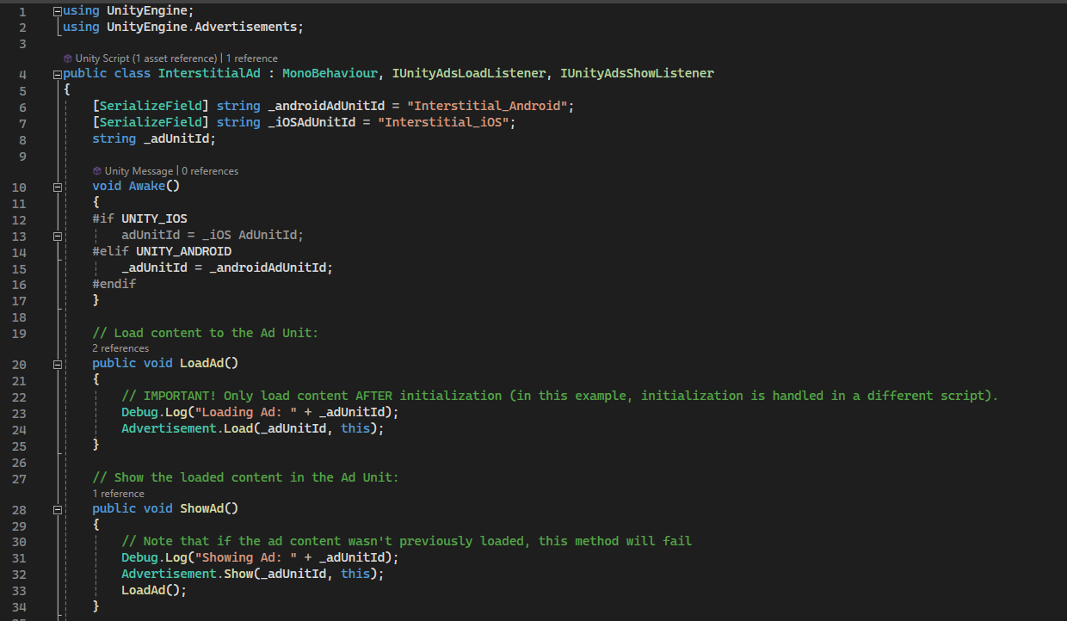
Code
Figure 2.6. InterstitialAd.cs. This script loads and shows the interstitial ads. There is also „LoadAd()” in the „ShowAd()” so that when one ad is shown, another one is already loaded up and ready to show on next game over.
Figure 2.7. BannerAd.cs. This script loads the banner ads and sets their position to the bottom center of the screen.

Slide 13
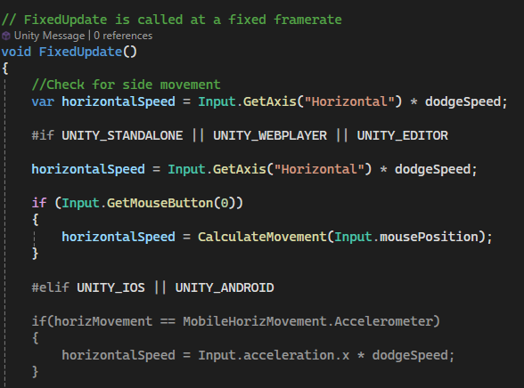
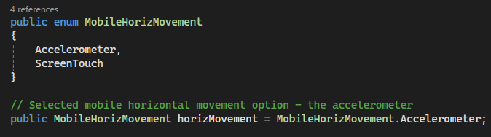
Code
Figures 2.8 and 2.9. PlayerMovement.cs. These pieces of code are in the same script. This is specifically the code for the accelerometer which is used for movement on the mobile device.

Slide 14
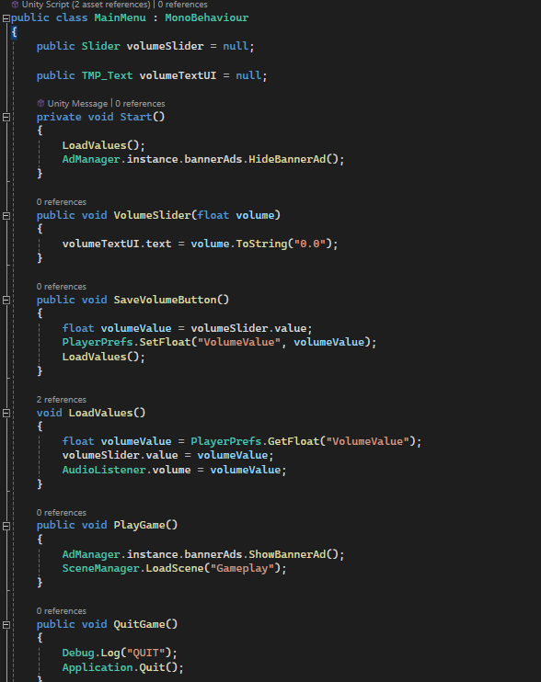
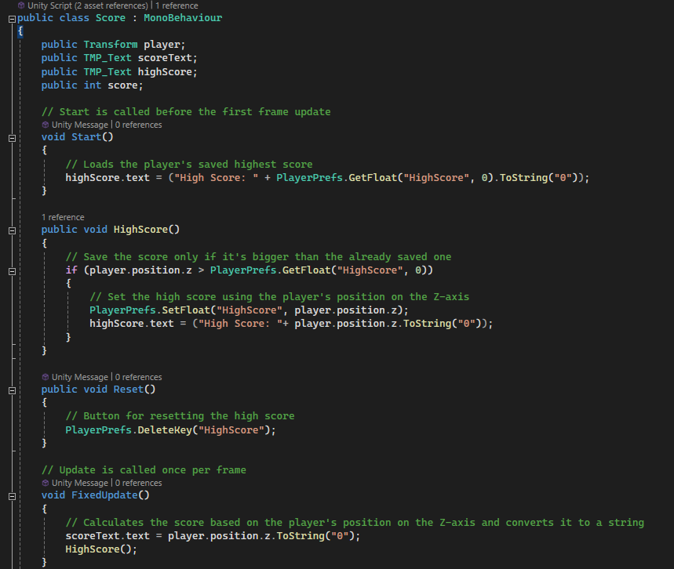
Code
Figure 3.0. Score.cs. This script calculates the score based on player’s position (converts their z-axis position to string and rounds it up to the nearest whole number). It also saves the player’s highest score. Whenever the score beats the high score, it gets overwritten using playerprefs.
Figure 3.1. Main Menu.cs. This script loads the game scene when the play button is clicked. Also, it uses playerprefs to save and load the volume settings.

Slide 15
Improvements
Add pause and game over screens
Add audio to the game
Improve the UI by making it more visually appealing (e.g. Add a progress bar, play around with the fonts)
Add vibrations to the game (e.g. When a button is clicked or player collides with an obstacle)
Add rewarded ads (make the most out of Unity Ads, increase player satisfaction)
Add animation to the player when they move left and right

Slide 16
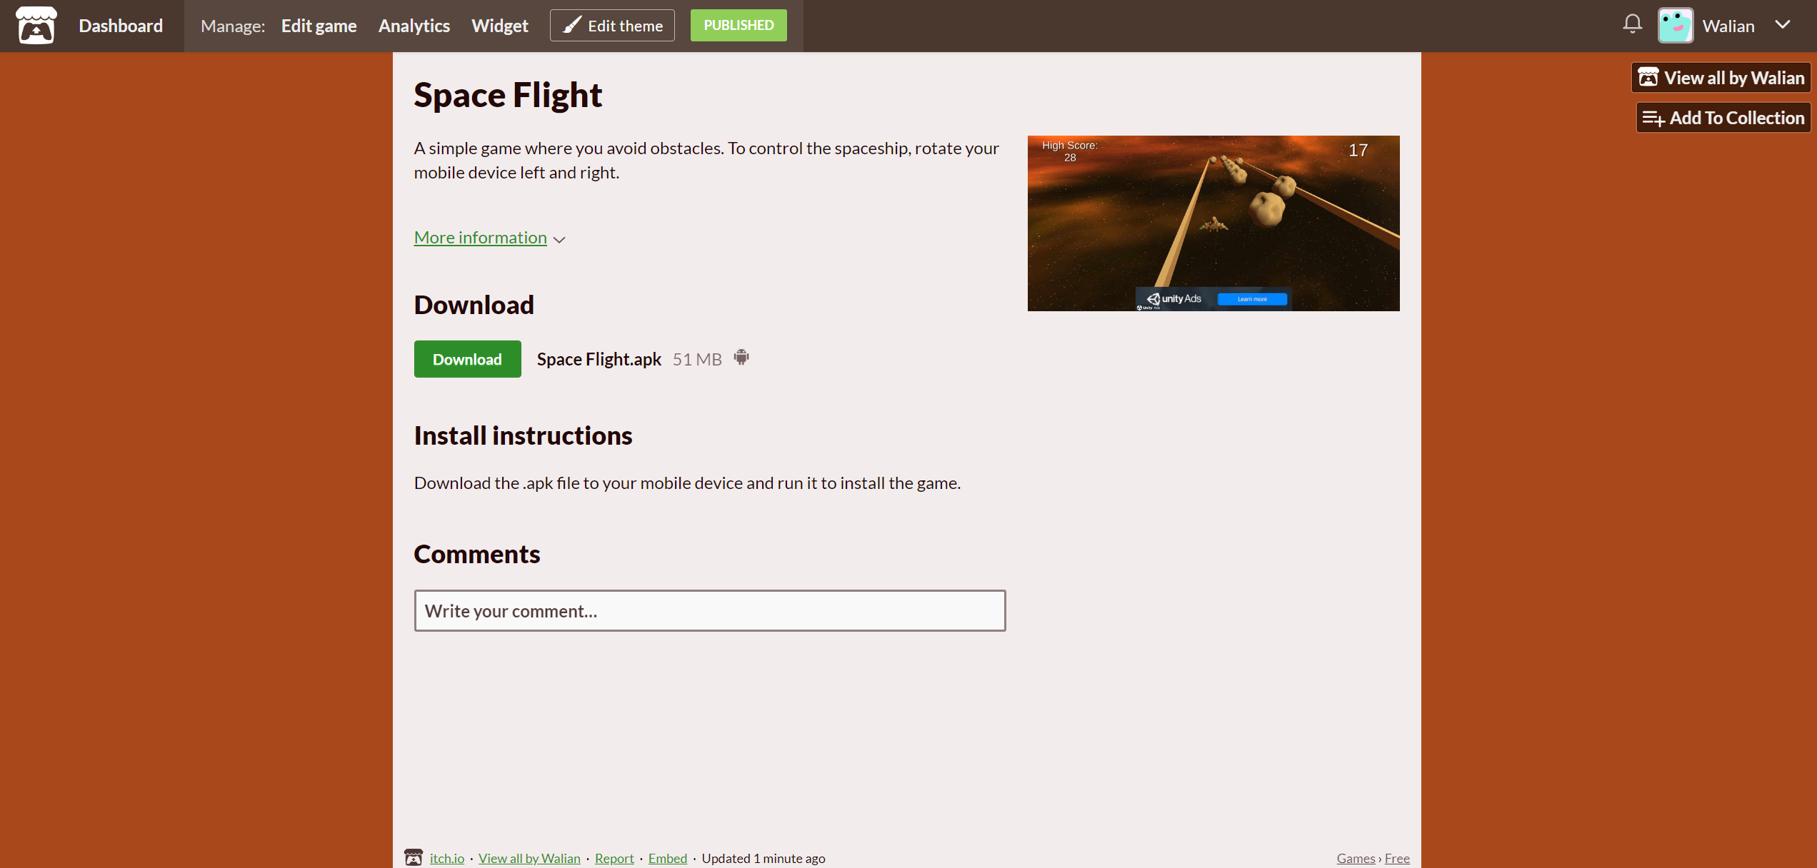
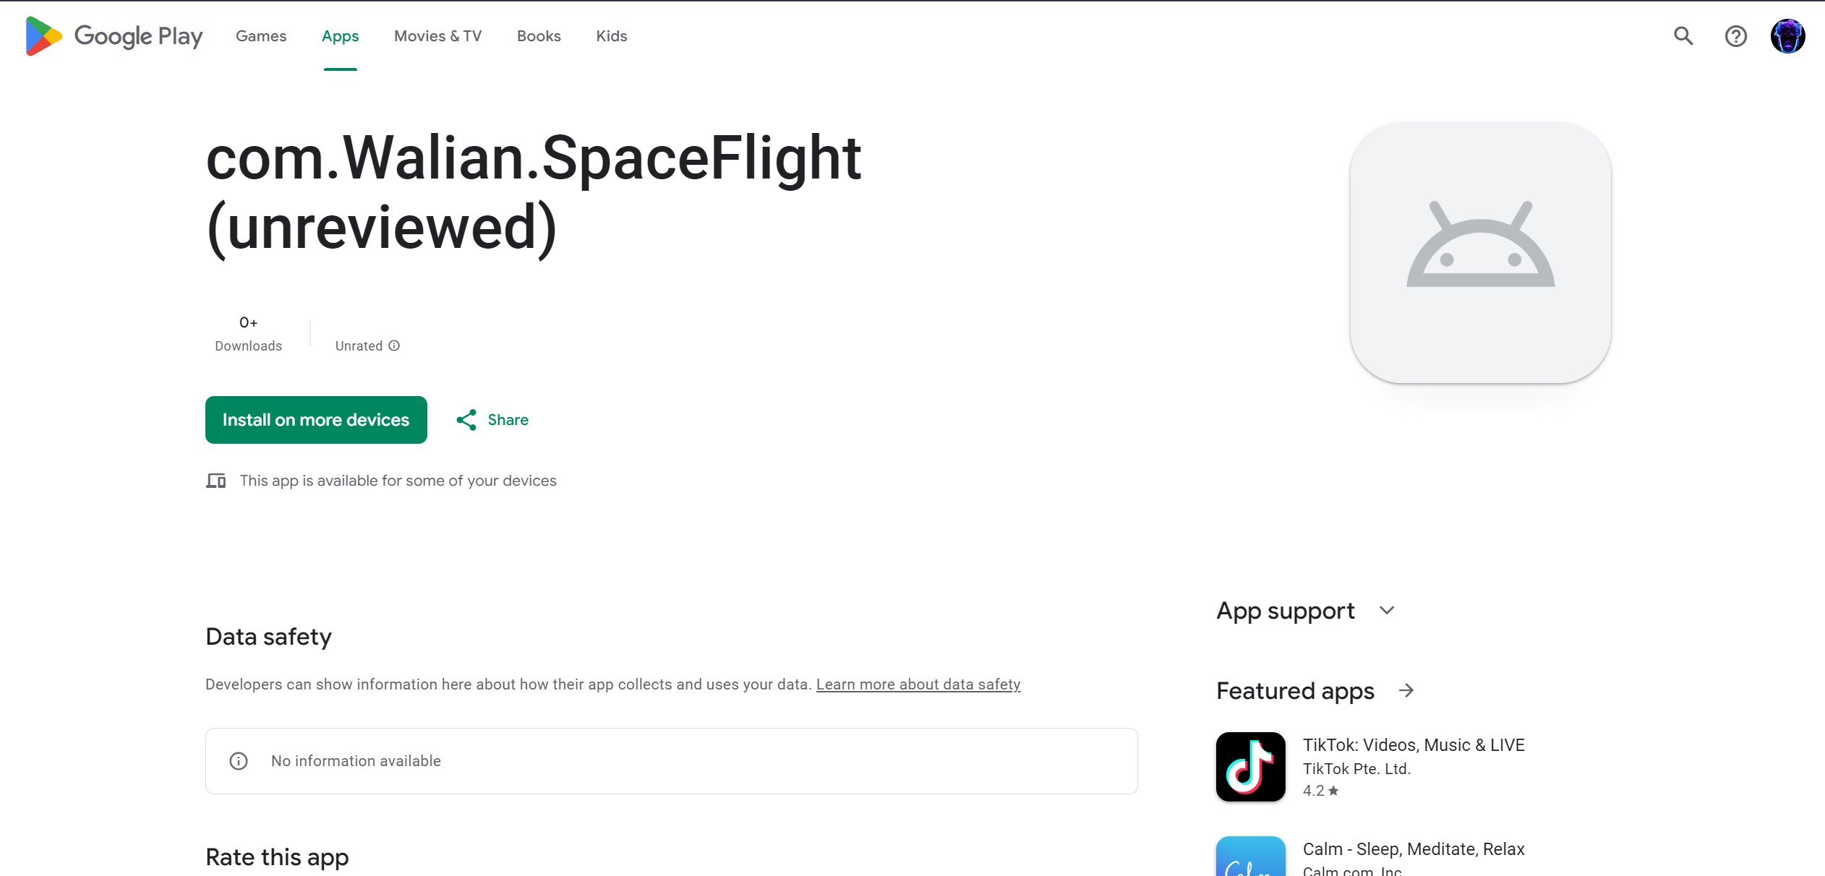
Publishment
Figure 3.1. Itch.io Page. The game is published to itch.io. Link: https://walian.itch.io/space-flight
Figure 3.2. Google Play Page. The game is published for internal testing on the Play Store. Link: https://play.google.com/apps/internaltest/4699188045531652637
(the internal test can be accessed through the account provided on moodle).

Slide 17
References
Skybox texture by Dogmatic: https://assetstore.unity.com/packages/2d/textures-materials/sky/free-skyboxes-space-178953
Spaceship model by Funky Finger Productions Inc.: https://assetstore.unity.com/packages/3d/galactic-heroes-cartoon-spaceship-70188
Main menu script: https://youtu.be/TAGZxRMloyU?si=Nq37pMTZN7JIru7d
Unity Ads scripts: https://youtu.be/seTvVkaU2dk?si=9ScMl7sPKSxByRbk
UI Buttons by Feidry: https://opengameart.org/content/simple-ui-buttons
Asteroid Model by exabyte: https://sketchfab.com/3d-models/asteroid-01-df95d3da67aa4c769ec81394e0b0ffef

